Slide 1


SAP UI5 & FIORI with OData TRAINING
Anubhav Oberoy & Nishan Nainsukha
Day – 19

Slide 2

Agenda – Day 18
Fiori System Architecture
Fiori App Ref. Library
Two types of SAP-Fiori app implementations
ABAP Deployment
Fiori Launchpad
Relationship between Front-End Components
Trainer: Anubhav Oberoy & Nishan

Slide 3
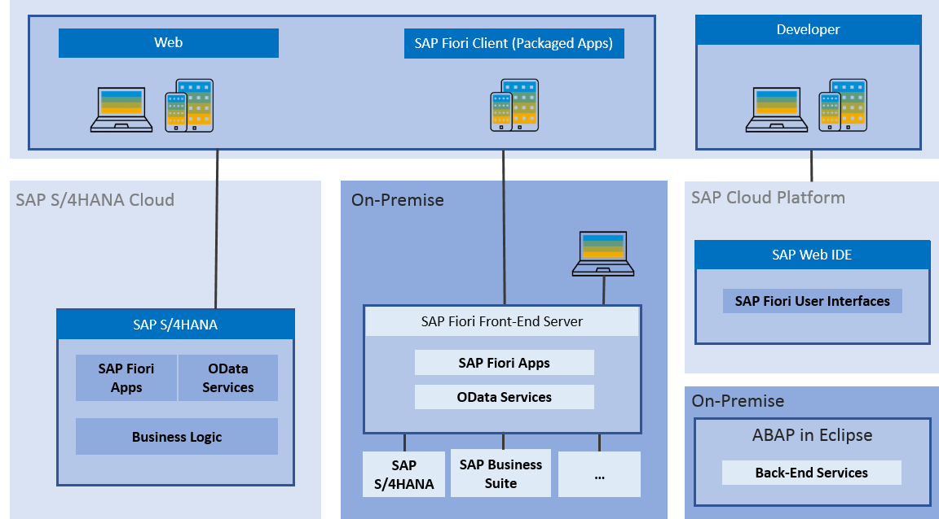
Fiori System Architecture
The SAP Fiori architecture introduces the high-level architecture of SAP Fiori.
The SAP Fiori apps are built with SAPUI5 technology for web applications and iOS native and can be used on smartphones, tablets, and desktop computers.
The SAP Fiori launchpad is used to launch and run the apps.

Slide 4
Fiori App Ref. Library
It’s a library which tells us all the list of Fiori Apps and Non-Fiori Apps offered by SAP as standard.
These apps are grouped under solutions and we can search particular app(s) based on different criteria
https://fioriappslibrary.hana.ondemand.com/sap/fix/externalViewer/
Total Apps – 11628
Fiori Apps - 2107
By Name, description
By Id & Product
By User function
By Id & Product
By Functional
Area – Finance, Sales, Marketing, Procurement
By Fnctnal
Area – Finance, Sales, Marketing, Procurement
By Functional
Area – Finance, Sales, Marketing, Procurement
By Role
By Role
Different Search Criteria

Slide 5
Two types of SAP-Fiori app implementations
Standard Apps
Implementation of those business apps, which are released by SAP
These are categorized as Transnational, Fact-sheets and Analytical apps etc.
Customized Apps
As per business requirement, a complete custom fiori app can be implemented.
Customized App is been hosted on SAP-Fiori server (front-end system).
It integrates with SAP or Non-SAP system.

Slide 6
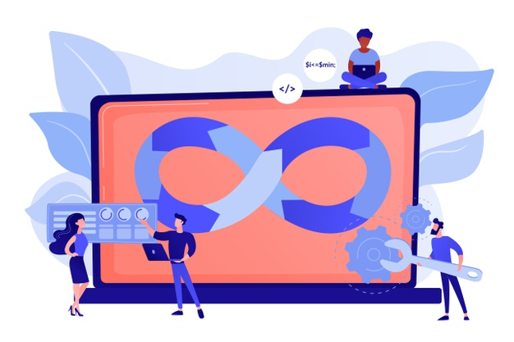
ABAP Deployment
Step1: Open the terminal in BAS and go to your project folder.
Step2: Write command ui5 init and press enter
Step3: Write command ui5 build and press enter
Step4: Write command abap-deploy and press enter
Step5: Specify the source folder path for deployment … ./dist
Step6: Select a target ABAP system … http://103.207.171.202
Step7: Enter the ABAP system client number …
Step8: Enter a username …
Step9: Enter a password …
Step10: Enter an application name …
Step11: Enter a description for the application …
Step12: Enter a package for the deployed application … $TMP

Slide 7
Fiori Launchpad
Just imagine, if my co. have developed 500 Apps in last Quarter, These 500 apps have got 500 URLs to access the app. As a end user, you would face below challenges
Finding url for each app is a challenge
Making sure that you are right person to access app – Security
Also you should only be able to see apps which you are allowed to access
SAP Portal is now deprecated, what options do we have to access all functionality of ERP
SAP Fiori Launchpad
Is a single access point for all the Applications in S/4HANA. Is available fiori frontend server once Fiori is installed in your SAP System.
We can configure apps to show all the apps belongs to Standard or Custom Category.
LPD comes with LPD Designer, which allows developer/consultant to configure access to the apps as a Tile. The tcodes are
/n/UI2/FLPD_CONF – Fiori Designer, /N/UI2/FLP – Actual Launchpad (End user)

Slide 8
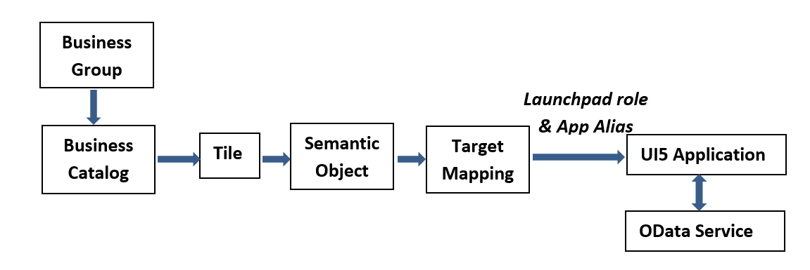
Relationship between Front-End Components

Slide 9

End of Day 19

Slide 10

Questions

Slide 11

Anubhav Oberoy

Slide 12


We’re committed to empower you to be
Most Desirable Resource
through powerful training solutions.
We build the workforce of the future.
250+
Corporate Clients
30,000+
Learners Trained
25000+
Learners Placed
FREE WEBINARS
Sign up for free webinars with industry experts every fortnight!
Enroll Now!
Contact us today!
https://anubhavtrainings.com/

Slide 13




More from AnubhavTrainings.com

